Slide 1
Major Project 2nd Review
Department No : 18 – PCA - 025
Student Name : S.GOPINATH
Company Name : Candid techno solution
Project Title : Dynamic concealment in
recital visual blockchain

Slide 2
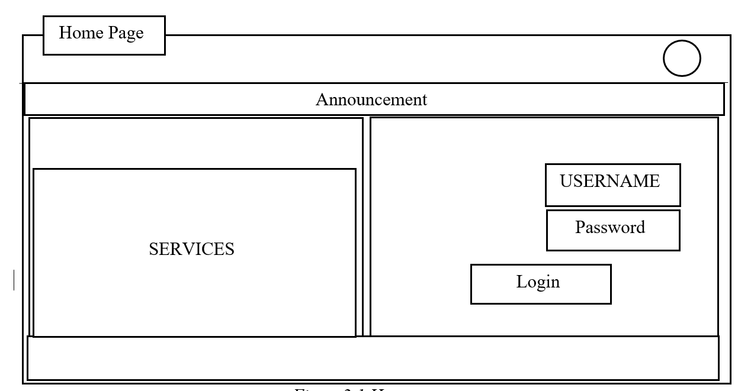
Method of solution
The system does not contain the Block Chain Technology for the application with High Security and Safe Processing of the users account transaction.
Data flow diagram
Pseudo form
3. Table Design

Slide 3
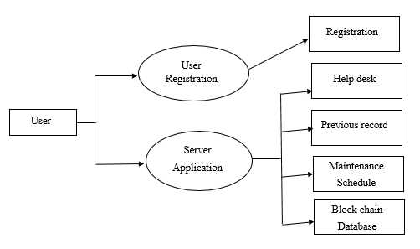
Data flow diagram

Slide 4
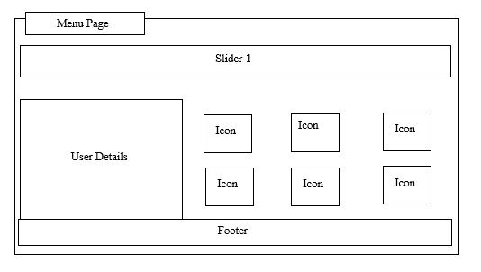
Pseudo form

Slide 5
Table Design
COLUMN NAME | DATA TYPE | DESCRIPTION
Name | Varchar(100) | Not Null
Email | Varchar(50) | Not Null
Account Number | Varchar(50) | Not Null
Branch location | Varchar(15) | Not Null
Username | Varchar(15) | Not Null
Password | Varchar(15) | Not Null
Confirm Password | Varchar(15) | Not Null

Slide 6
Hardware Requirements
Component |  | Configuration
Monitor |  | 15’’ LED
System |  | Pentium Dual Core
Processor |  | I5, Intel Core 8th Gen
RAM |  | 4 GB
Hard Disk |  | 120 GB and Above
System Type |  | 64-bit operating system
Input Devices |  | Keyboard , Mouse
Software Requirements
Specifications | Functional Requirements
Database | MYSQL
Programming Language | PYTHON
Operating System | Windows 7, 8 , and new Version
Tool | Pycharm , Anaconda

Slide 7
Method of solution related to problem
A web app is an application that the user does not download and instead accesses via a web browser over a network. Example web browsers include Google Chrome, Safari and Mozilla Firefox.
The best solution is to fix the data lose problem by data security to the registered user’s mobile phone and to store the data records in the application.
It also updated whenever needed. The queries raised by the user is also cleared by help desk simultaneously.
XRP server Connection
Message Verification
Data Storage
Help Desk

Slide 8
Testing
The following are the types of testing that have been done to check and overcome the errors in the web application.
Unit Testing
Integration Testing
Database Testing

Slide 9
Unit Testing
S. No | Module Name | Test Condition | Test Data/Input | Expected Result | Actual Result
1 | Login Module | Click on the login button after entering email id and password | Enter invalid email id & password | Message prompts that “check username & password” | Message prompts that “check username & password”
2 | Login Module | Click on the login button after entering email-id and password | Enter valid email id & password | Message prompts that “Successfully logged in” | Message prompts that “Successfully logged in”
3 | Registration Module | Click on submit button after entering the details of user | Enter invalid mobile number | Message prompts that “Mobile number should be of 10 digits” | Message prompts that “Mobile number should be of 10 digits”
4 | Registration Module | Click on submit button after entering the Mail id | Enter Invalid Email id | Message prompts that “Please check Mail id” | Message prompts that “Please check Mail id ”
5 | Registration Module | Click on submit button after entering the details of user | Enter valid Details | Message prompts that “Successfully Registered” | Message prompts that “Successfully Registered”

Slide 10
THANK YOU

